Slide 1


Project On Medical Colleges analysis ABOUT US : S . rahul N . DINESH

Slide 2
Problem statements: Medical College Seats States wise

Slide 3
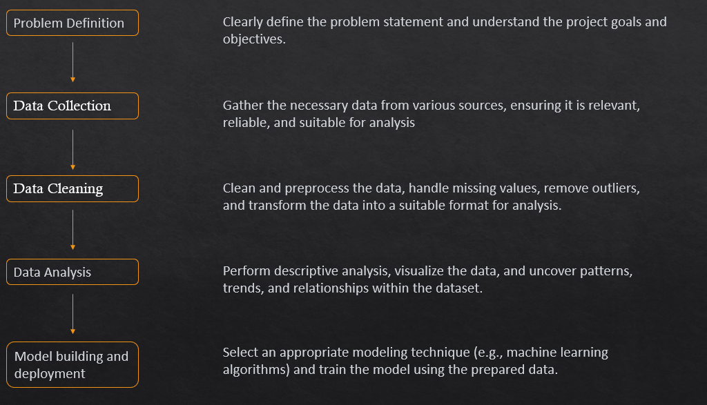
Data science life cycle :

Slide 4
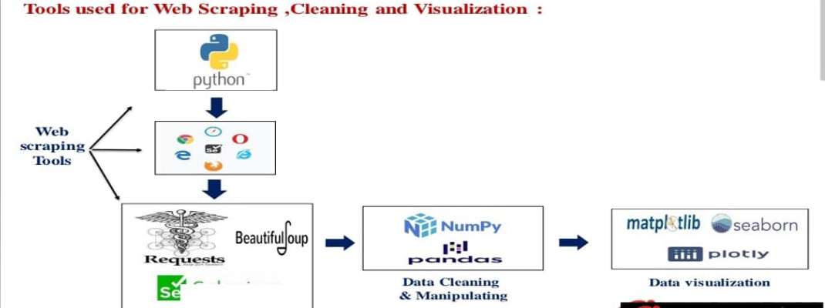


Libraries used :

Slide 5
Source :
Website address : https://www.indiaccess.com/colleges/medical/
We collected information from India Access
We collected :
City
Colleges
Seats
Type
Established Year

Slide 6
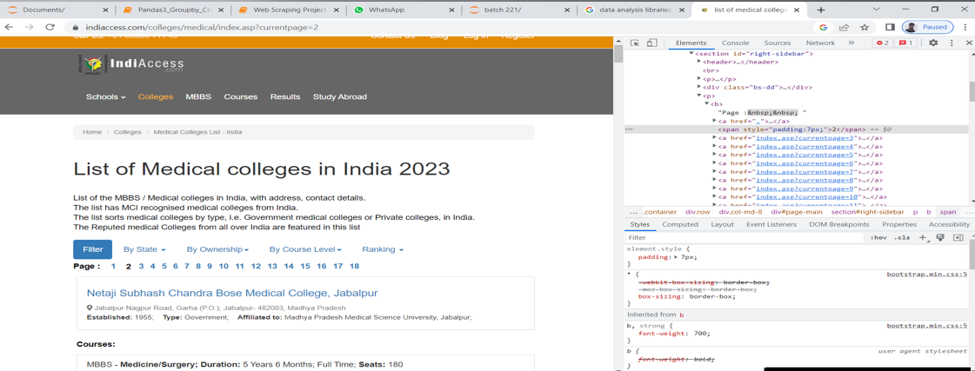
Data collection :

Slide 7
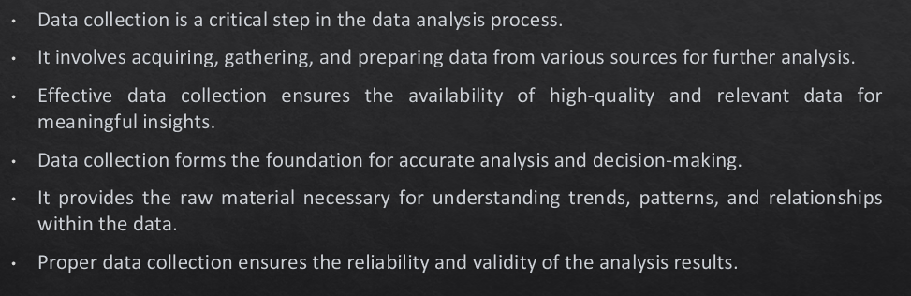
Data collection :

Slide 8
Data Collection :
For real time Analysis, Data is scraping from website : https://www.indiaccess.com/colleges/medical/
India Access Website for Medical colleges
Scrap the data using BeautifulSoup
Make a DataFrame from the URL
Save it to .csv

Slide 9
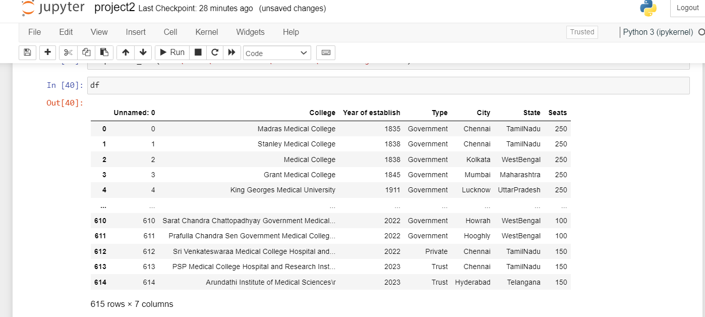
Data Set :

Slide 10

Data Cleaning :

Slide 11
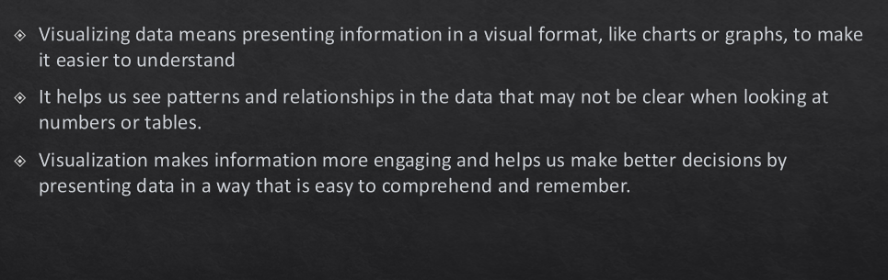
Visualization :

Slide 12

Data analysis :

Slide 13
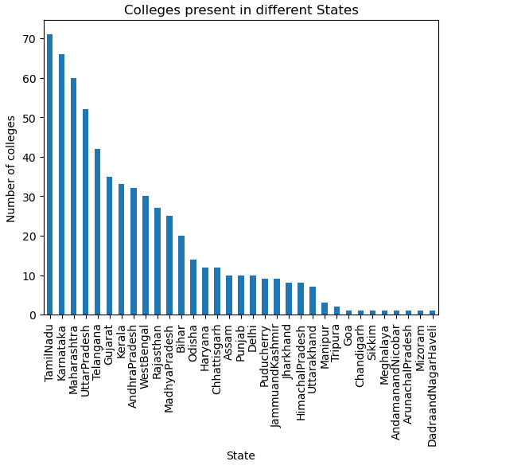
Visualization
Identifing, the number of Medical colleges
Present in each state
Tamilnadu, as highest number of Medical colleges
Goa , chandigarh , Sikkim ,mizoriam , Arunchalpradesh,
Dadranagarhaveli have least number of medical colleges

Slide 14
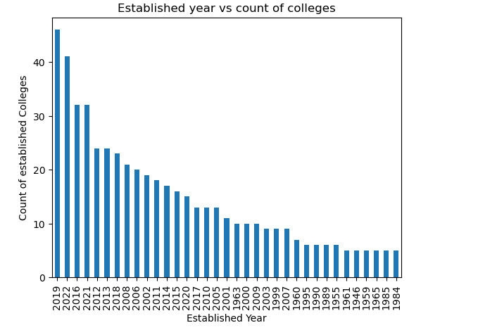
Visualization
Identifing the number of Medical colleges
Established in a year
In 2019 , 46 colleges are established in India
1981, 1845 , 1924, 1923, 1911 are the years
with less establishment of medical colleges

Slide 15
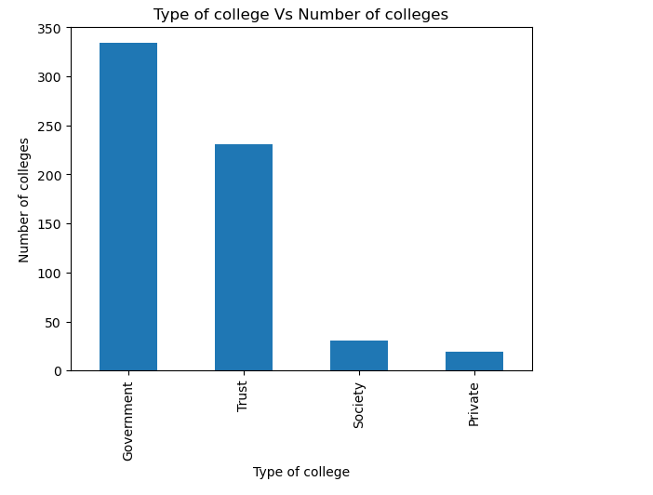
visualization
Identifing the number of colleges based on
there type i.e., Government, Private, Trust, Society
Most of the colleges run by the government
Private colleges are least in number

Slide 16
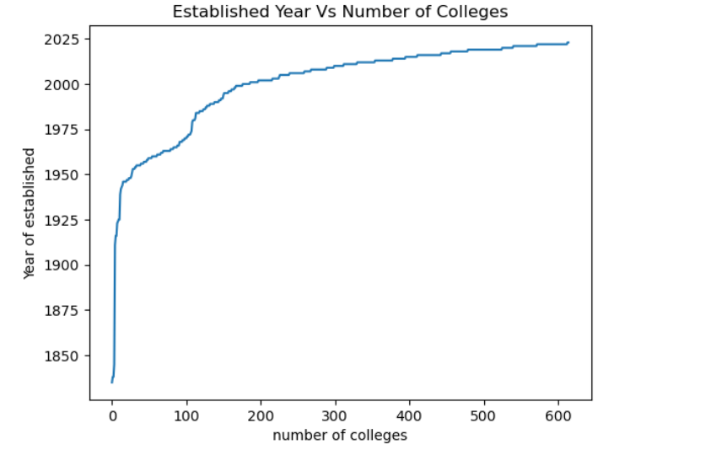
Visualization
Increment of medical colleges in India from
1850 to 2022.

Slide 17
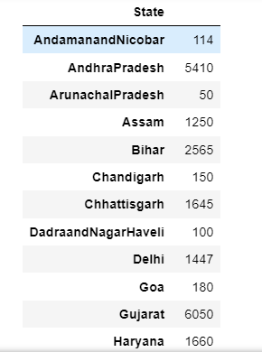
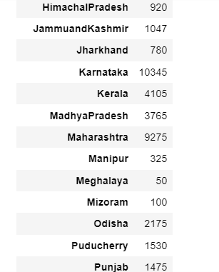
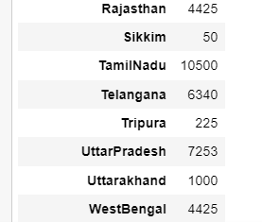
Identifing number of seats in each state

Slide 18
Challenges Faced
While extracting College data, all the information of the college is stored in a single tag
By doing regex we can over come this problem.
Topic Selection is the biggest challenge and data collection.

Slide 19
Conclusion :
In the data there is no relation between established year and seats if the established year is increased but seats are not increased
Gradually the medical colleges are increased from 2000 to 2023 compare with 1900s to 1970.
The arunachalPradesh, Skkim and Meghalaya having least total seats of 50 states wise and tamilnadu having high total seats of 10500 states wise.

Slide 20


